Slide 1
GUI-RITS(ver1.5.0) profile shape memo 05/28/2025
Change slide p4 for ver1.5.1, 2025/08/28

Slide 2
Convolution of the Jorgensen function with the Heaviside’s step function
Jorgensen type Bragg edge profile function
You can find these mathematical formula in the reference paper.
Notes:
Aim of the data analysis code is the quantification of various crystalline structural information in Bragg-edge transmission imaging. (+0:1 min = 1:2 min)

Slide 3
Jorgensen function for TOF diffractometry
You can also find these mathematical formula in the reference paper.
But you may not find these mathematical formula in the reference paper.
Broadening parameters
width
rise
decay
Notes:
Aim of the data analysis code is the quantification of various crystalline structural information in Bragg-edge transmission imaging. (+0:1 min = 1:2 min)

Slide 4
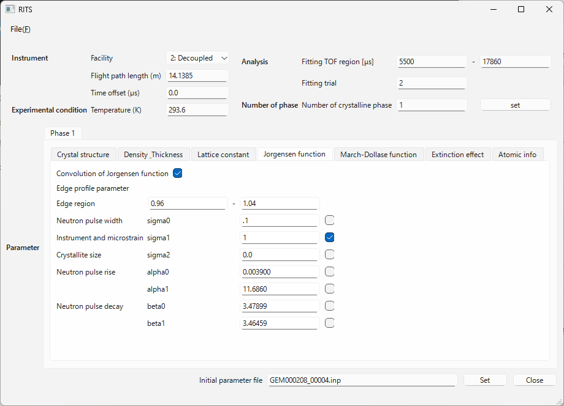
“Decoupled” has to be selected for BL10 and BL22 at J-PARC. If you make a mistake, the parameters will change by a factor of 10.
enter the value of t0 if you need.
This is the only one that is not a flag for refinement. Basically on.
There is no need to be wastefully wide. About this much.
Refine after the lattice constant close enough.
Facility | Moderator | Sigma0 | Sigma1 | Alpha | Beta
1 | Coupled | x10.0 | x10.0 | x0.01 | x0.001
2 | Decoupled | x10.0 | x10.0 | x0.01 | x0.01
3 | Poisoned | x1.0 | x1.0 | x0.01 | x0.01
4 | LARMOR | x10.0 | x10.0 | x0.001 | x0.001
Broadening parameters
Neutron pulse width
Instrument and micrstrain
Neutron pulse rise
Neutron pulse decay
Crystallite size
Furthermore, in the case of RITS, σ is supposed to be 1/10 of its true value, and α and β are supposed to be 100 times their true values, which makes it a bit confusing.

Slide 5
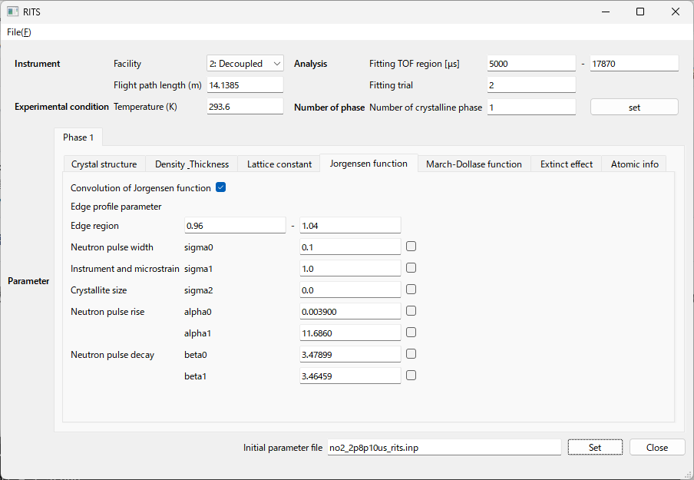
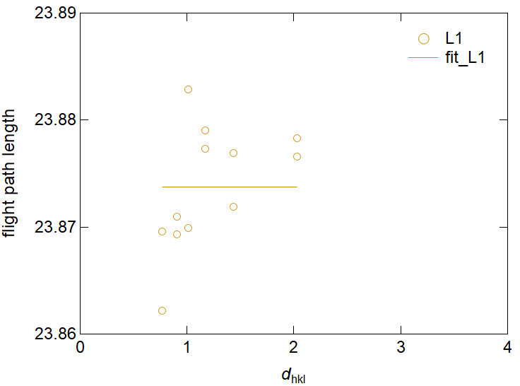
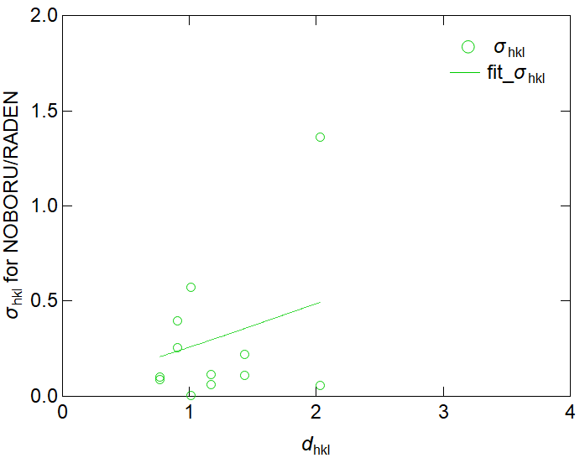
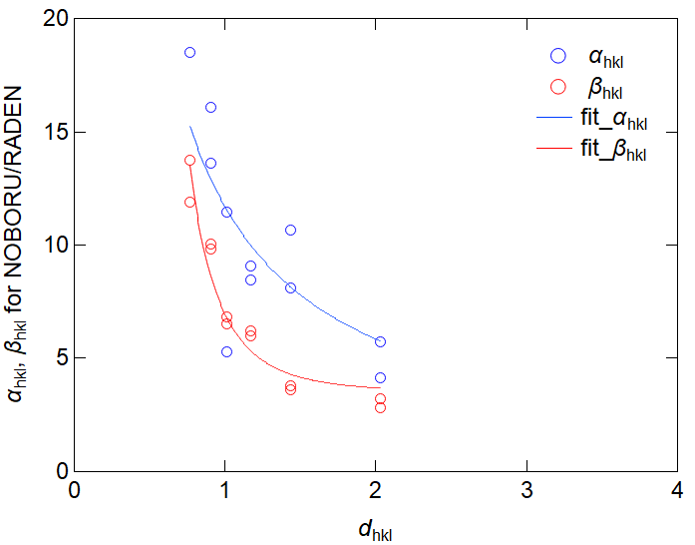
Individual peak fit of standard iron sample(s).
t = λ × 252.778 × L1+ t₀
We fix t₀ = 0.
In this curve-fit, sigma0 and sigma2 were fixed to 0.1 and 0, and the converged value of sigma1 was 0.24(9).
In these curve-fit, alpha0, alpha1, beta0 and beta1 were converged to these values, respectively.

